Slide 1
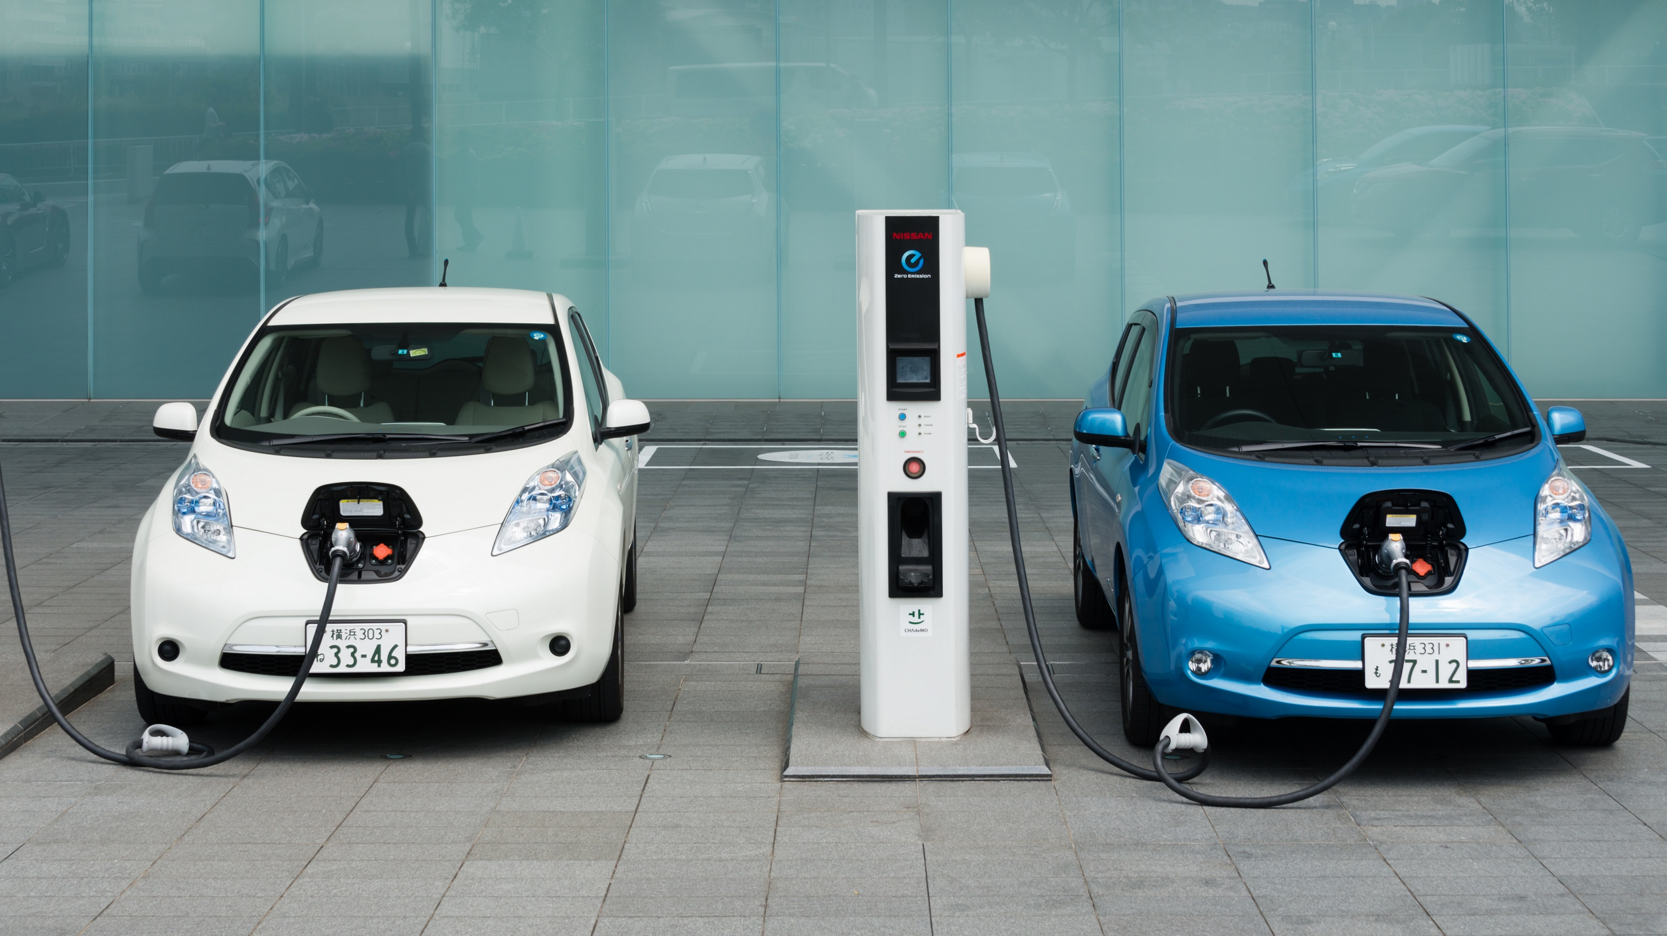
Electric cars
What is an electric cars ?
Samuel Litzler STS1 2018 - 2019

Slide 2
Table of content
Presentation of the electric car
History
How does it work?
Advantages and cons
3 examples of electric cars
2

Slide 3
Presentation of the electric car
Type of car | Electric car | Petrol car
Type of power | Battery | Fuel / Petrol … fosille energies
Stations | Public and at home | Only public
Range | 50 – 200 km (depend on the battery and the environnement) | 800 – 1200 km (depend on the type of petrol car and)
Uses | City | City and long trips
Price | Often around 10 K | Depend on the type of car
3

Slide 4
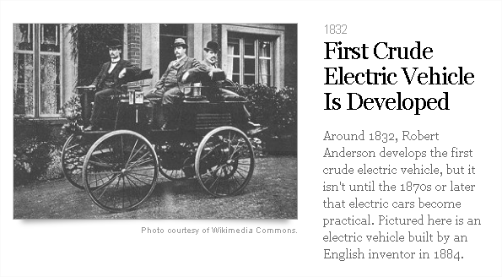
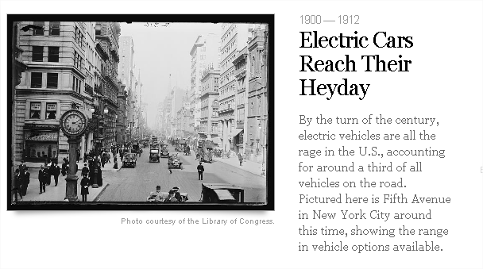
History
4

Slide 5
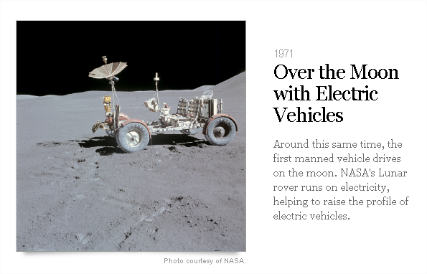
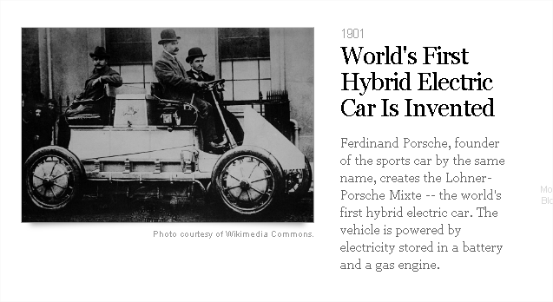
5

Slide 6
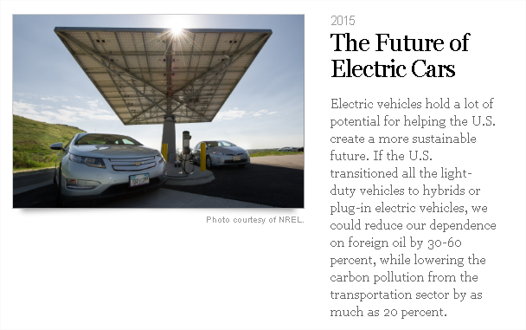
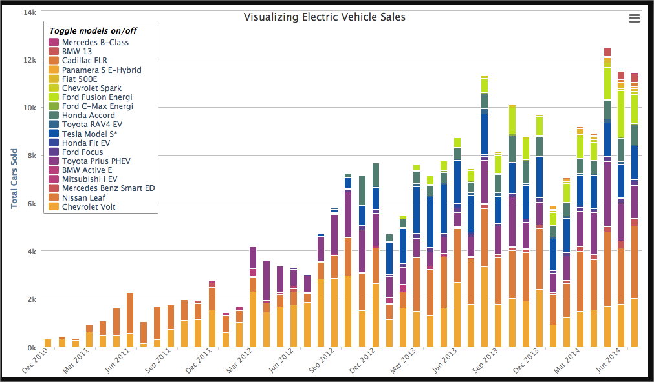
6

Slide 7

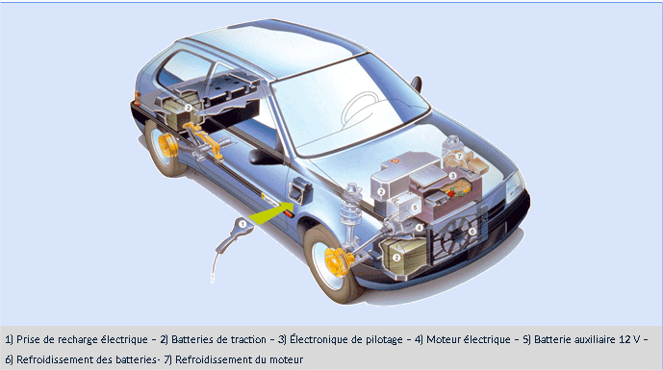
How does it work?
Electric motor (with magnet inside the motor)
Without clutch (cant stalled)
Without gearbox (motor shaft turns directly on that of the driving wheels of the car without the use of pistons)
Battery
7

Slide 8
Advantages and cons
no CO2 emission
It is silent
the car never stalls
very limited maintenance
Instantly start
a clean and cheap energy (2 euros / 100 km)
8

Slide 9
3 examples of electric cars
Owner | Gareth Jefferies | Katy And anthony Butcher | Phyl Brinicombe
Second hand car ? | Yes | Yes | Yes
Reasons of the choice | More range and faster than the oldest car | Saved money | Cheaper in UK
Power / Range | Range reduced in the cold (around 30km) | 28kwH / 250km | 30kwH / 150 km
Advantages | More range | Cheaper, less sound, low cost of electricity, saved 1K a year | Not polluting
Price and brand | BLW i3 | 23 000 euros / Hyandai Joniy | 14 450 £ / Nissan leaf
Drawbacks | Range reduced in the cold | Having to plan longer journey | Long trips are planned carefully
Opinion | «An electric vehicle is an ideal second car » | « We are happy of this purchase » | « It is lovely knowing that you are not polluting »
9

